Slide 1
POSITIVE PLENARY Session 1
Speaker: Sharon Amesu
Licensed Facilitator for Care for the Family

Slide 2
Part 1: Rekindling the Passion of the Educator
Part 2: Harnessing Parent Potential. 22/11/17
Part 3: Building Resilience in Kids. 6/12/17

Slide 4
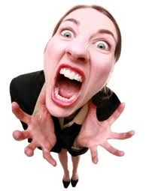

Slide 5
Ups and Downs, surprises, disappointments, hopes, joys.

Slide 7
Birthing Choices
Breast feeding
Sleep in your room/ sleep alone
Weaning decisions
Nursery/Stay at Home Parenting
Party decisions
SAT’s
Entrance Exams
University Choices

Slide 8
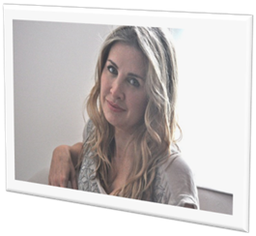
“Parents are made to constantly fear that they are never doing enough to help their children succeed in a cut-throat world of work and higher education.”
Tanith Carey
Taming the Tiger Parent

Slide 9
Notes:
.

Slide 10
What are the top 3 challenges you face in modern life as a parent?
Discuss

Slide 11
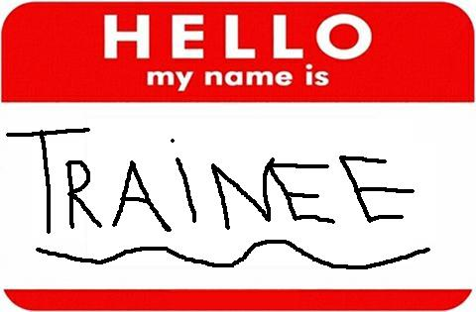
“The unexamined life is not worth living.”
Socrates

Slide 12
Seven Habits of Highly Effective Families
#2 Begin with the End in Mind
Stephen Covey

Slide 13
What is the goal of parenting?

Slide 14
What would you say are the main influences on your Parenting?
Cultural/ Societal/ Religious/ Personalities/Relationships
Social Media
Marketing
Soap Operas (TV)
Film
Music Industry
Colleagues
Work Environment

Slide 15
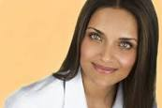
“What is my parenting mission, my parenting philosophy? How do I manifest this in my everyday interaction with my child? Have I mapped out a thoughtful, mindful mission, as I would were I running a major organization?”
― Shefali Tsabary, The Conscious Parent

Slide 17
A mission statement sets out the long-term direction of the organisation.
Marks and Spencer, Poundland, Asda
1.”to be Britain's best-value retailer exceeding customer needs always‘”.
2. “To create a retail environment that offers unbelievable value and variety and satisfies customers of every lifestyle.”
3. “To be the standard against which others are measured, to make aspirational quality accessible to all and quality value, service, innovation and trust.”
Notes:
Full Steam Ahead

Slide 18
1.
2.
3.

Slide 19
Family Vision and mission

Slide 20
“A family mission statement is a combined, unified expression from all family members of what your family is all about- what you really want to do and be- and the principles you choose to govern your life.”
Steven Covey
Seven Habits of Highly Effective Families
Notes:
Shopping list for life. We forget. 5 p bags.

Slide 21
Family Coaching Questions:
What does family mean to you?
What are some things you really like about your family?
What kind of family do you want to be?
What kind of feeling do we want to have in our home?
What kind of home would you like to invite your friend too?
What makes you want to be at home instead of someone else’s house?

Slide 22
Get a clear Vision for yourself and for your family.

Slide 23
What is a Mission Statement?
A Mission statement:
Defines the present state or purpose of an organization;
Answers three questions about why an organization exists -
WHAT it does;
WHO it does it for; and
HOW it does what it does.

Slide 24
Our Family Vision Statement: Discuss

Slide 25
Who do you want to be as a parent?

Slide 26
Reflecting back on your childhood, who was the most significant adult in your life and why?
What single word or phrase would you use to describe them?

Slide 27
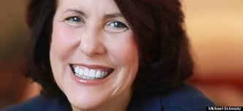
“Most of us are so busy trying to meet multiple and often overwhelming demands that we neglect to carve out the time and space we need..”
Dr Madeline Levine
Teach Your Children Well

Slide 28
How do we bridge the gap between where we are and where we want to be as family and in our parenting?

Slide 30
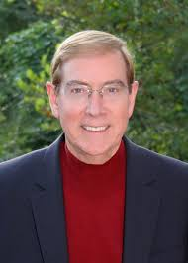
5 Love Languages
-Acts of Service
-Quality Time
-Words of Affirmation
-Gifts
-Physical Touch
www.5lovelanguages.com

Slide 31
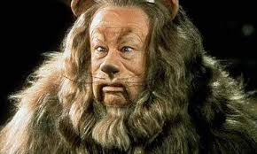

Slide 32
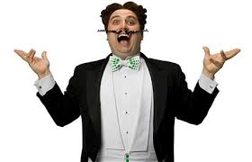
Positive Plenary Programme

Slide 33
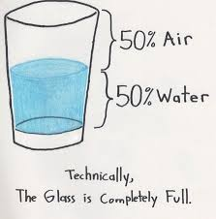
Positive Plenary Programme

Slide 34
Today was the absolute worst day ever
And don't try to convince me that
There's something good in every day
Because, when you take a closer look,
This world is a pretty evil place.
Even if
Some goodness does shine through once in a while
Satisfaction and happiness don't last.
And it's not true that
It's all in the mind and heart
Because
True happiness can be attained
Only if one's surroundings are good
It's not true that good exists
I'm sure you can agree that
The reality
Creates
My attitude
It's all beyond my control
And you'll never in a million years hear me say
Today was a very good day

Slide 35
Positive Plenary Programme
-Stronger immune systems and lower blood pressure;
-Higher levels of positive emotions;
-More joy, optimism, and happiness;
-Acting with more generosity and compassion;
-Feeling less lonely and isolated.

Slide 36
Positive Plenary Programme
“The best quality a parent can offer their child is their own happiness, contentment and felicity.”
Tom Hodgkinson
The Idle Parent

Slide 37
Positive plenary programme
QUESTIONS?
CONTRIBUTIONS?
THOUGHTS?

